Slide 1

Presentation on
CUSTOMER RETENTION DATA ANALYSIS
Submitted by:
PAYAL GUPTA
Internal Guide
Sapna verma
SME
Flip Robo Technologies
PGP Instructor
Dr. Deepika Sharma
Training Head
DataTrained

Slide 2
Objective: Perform a detailed EDA on Customer Retention Dataset.
Purpose :
Customer satisfaction has emerged as one of the most important factors that guarantee the success of online store.
It has been posited as a key stimulant of purchase, repurchase, intentions and customer loyalty.
Capturing the audience’s attention and converting them into paying customers is paramount for online businesses in a fiercely competitive e-commerce market.
Driven by the need to succeed, more and more businesses are turning to artificial intelligence (AI) and data science applications in e-commerce to maximize customer retention and conversion.

Slide 3
Motivation :
Data science involves proficiently using underlying fields such as statistics, mathematics, and programming to develop an understanding of trends and patterns in structured and unstructured data.
This data is deciphered into actions for defining customer acquisition and retention strategies by e-commerce businesses.
Since increasing conversion propensity is the bottom line for e-commerce businesses, the insights on user behavior provided by customer analytics help target the right set of customers.

Slide 4
Exploratory Data Analysis

Slide 5
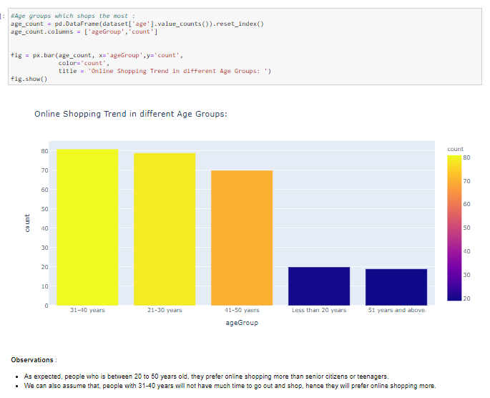

Slide 6
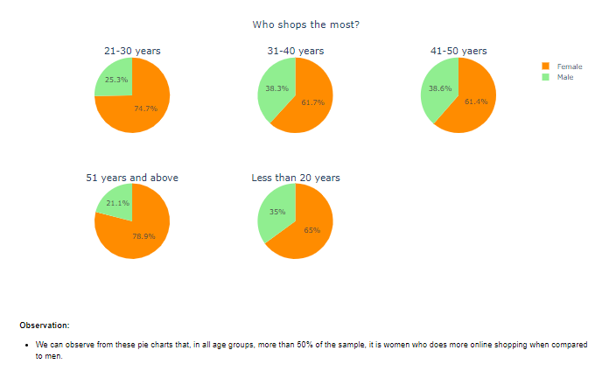

Slide 7
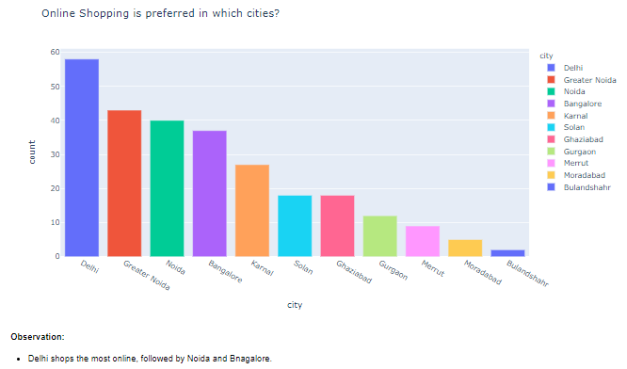

Slide 8
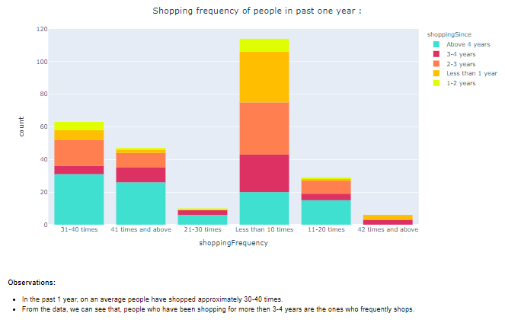

Slide 9
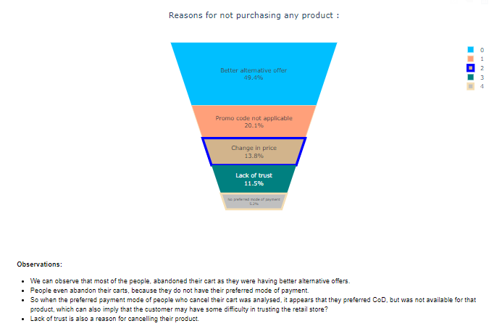

Slide 10
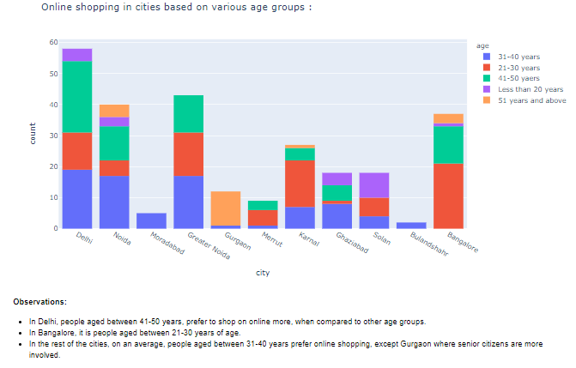

Slide 11
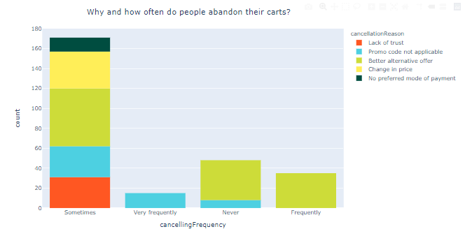

Slide 12
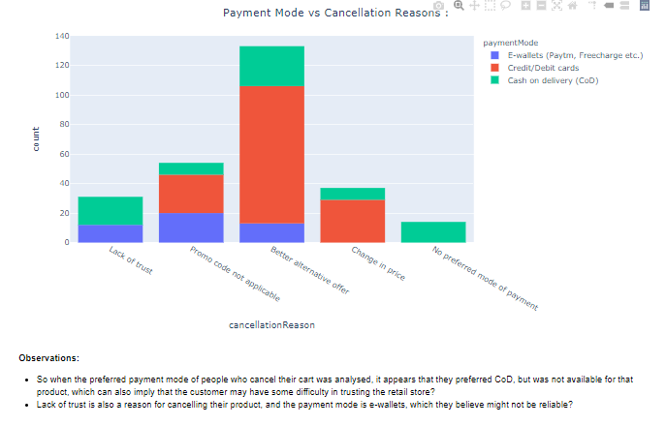

Slide 13
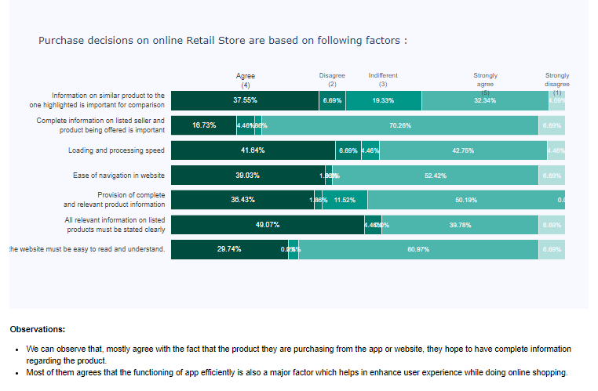

Slide 14
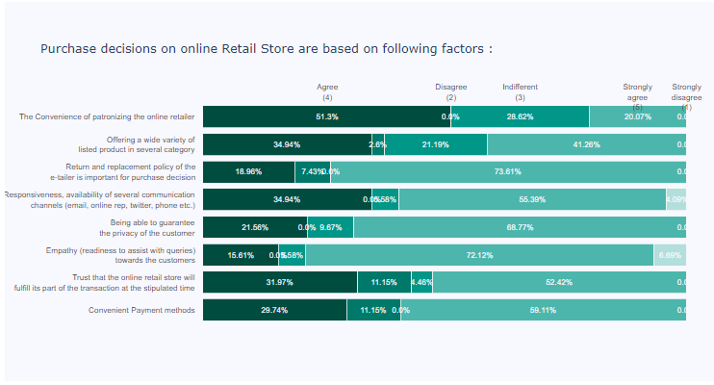

Slide 15
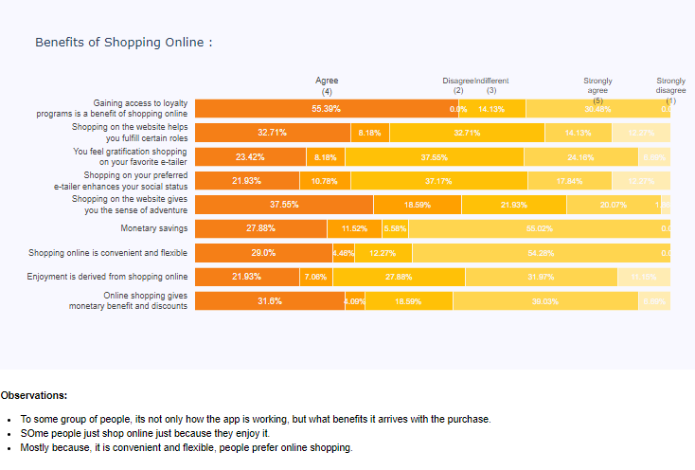

Slide 16
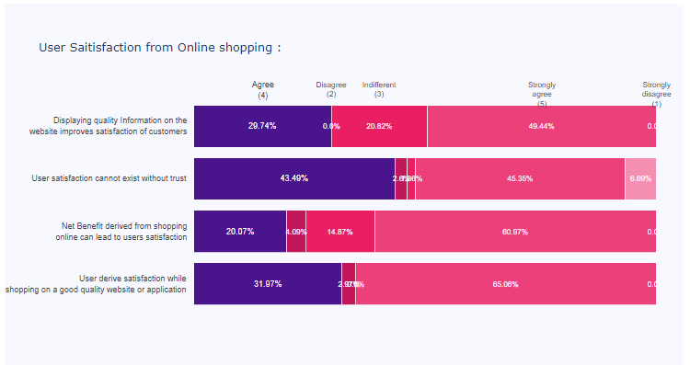

Slide 17
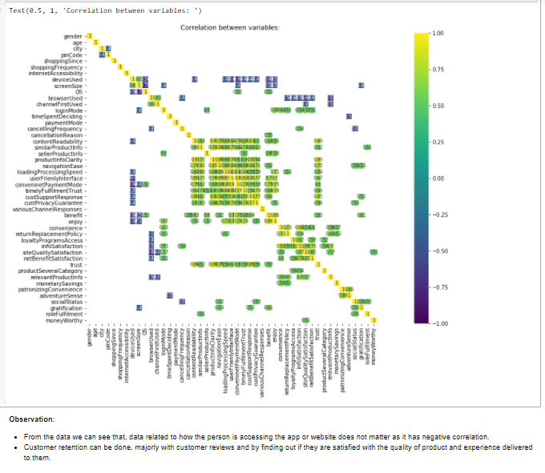

Slide 18
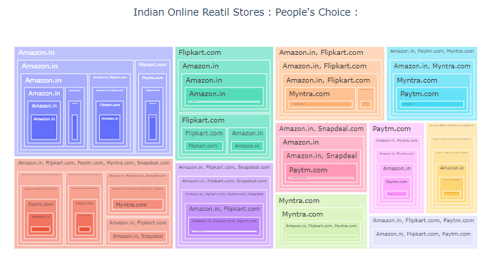

Slide 19
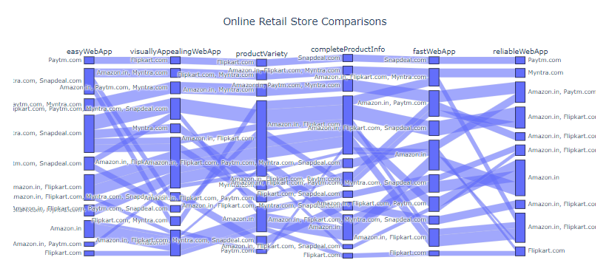

Slide 20
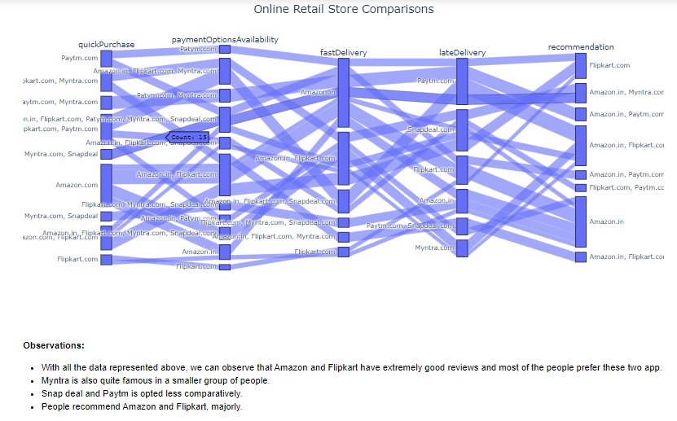

Slide 21
Key Conclusions from the EDA process done

Slide 22
People who is between 20 to 50 years old, they prefer online shopping more than senior citizens or teenagers.
We can also assume that, people with 31-40 years will not have much time to go out and shop, hence they will prefer online shopping more.
We can observe from these pie charts that, in all age groups, more than 50% of the sample, it is women who does more online shopping when compared to men.
Delhi shops the most online, followed by Noida and Bangalore.
Surprisingly, in Delhi and Noida, males prefer online shopping more than females. So we know our target audience in these cities,right?
Bulandshahr and Moradabad - both cities in UttarPradesh no female shoppers at all !!
In Delhi, people aged between 41-50 years, prefer to shop on online more, when compared to other age groups.
In Bangalore, it is people aged between 21-30 years of age.
In the rest of the cities, on an average, people aged between 31-40 years prefer online shopping, except Gurgaon where senior citizens are more involved.
In the past 1 year, on an average people have shopped approximately 30-40 times.
From the data, we can see that, people who have been shopping for more then 3-4 years are the ones who frequently shops.
We can observe that most of the people, abandoned their cart as they were having better alternative offers.
People even abandon their carts, because they do not have their preferred mode of payment.

Slide 23
So when the preferred payment mode of people who cancel their cart was analysed, it appears that they preferred CoD, but was not available for that product, which can also imply that the customer may have some difficulty in trusting the retail store?
Lack of trust is also a reason for cancelling their product.
We can observe that, mostly agree with the fact that the product they are purchasing from the app or website, they hope to have complete information regarding the product.
Most of them agrees that the functioning of app efficiently is also a major factor which helps in enhance user experience while doing online shopping.
To some group of people, its not only how the app is working, but what benefits it arrives with the purchase.
SOme people just shop online just because they enjoy it.
Mostly because, it is convenient and flexible, people prefer online shopping.
From the data we can see that, data related to how the person is accessing the app or website does not matter as it has negative correlation.
Customer retention can be done, majorly with customer reviews and by finding out if they are satisfied with the quality of product and experience delivered to them.
With all the data represented above, we can observe that Amazon and Flipkart have extremely good reviews and most of the people prefer these two app.
Myntra is also quite famous in a smaller group of people.
Snap deal and Paytm is opted less comparatively.
People recommend Amazon and Flipkart, majorly.

Slide 24
THANK YOU

